Slide 1
Measure of metrics – III
Closeness and Betweenness
MA 653: Network Science
Instructor: Ashok Singh Sairam
ashok@iitg.ac.in

Slide 2
Closeness centrality
Measures the mean distance from a vertex to the rest of the network
Let d_{ij} is the length of the shortest path between i and j, then the mean distance from i to any other node is:
Vertices that are separated from other nodes by short geodesic distances have a low l_{i} value
Meaning such nodes have direct influence on others or better access
Not considering the summation term for j=i we get:

Slide 3
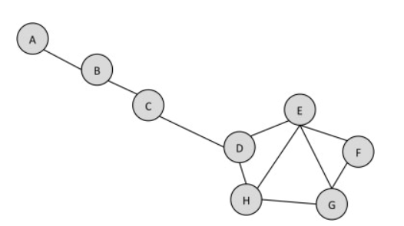
Ex: Closeness centrality
Compute the closeness centrality of node D

Slide 4
Closeness centrality
In contrast to other centrality measures, l_{i} gets smaller values for central nodes
Hence closeness centrality C_{i} is given by:
Closeness centrality is a natural measure used in many networks

Slide 5
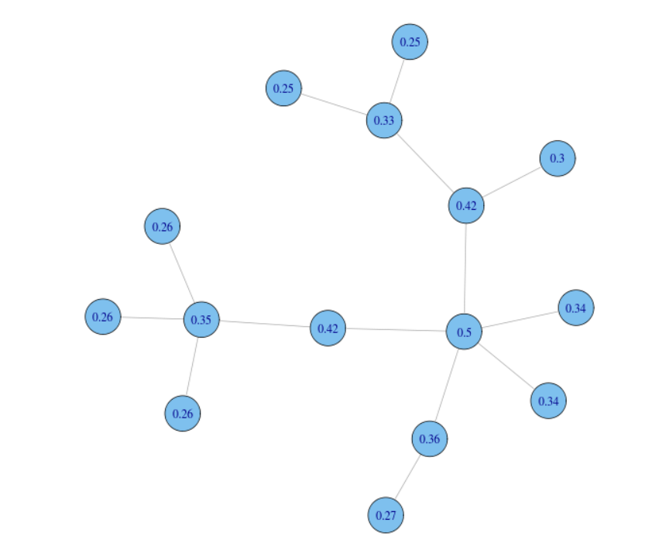
Ex: Closeness centrality
A problem with closeness centrality is that its value’s dynamic range is relatively close
Small changes in the network can cause large fluctuations and ranking changes
Other centrality measures we have examined do not typically suffer from similar problems
Especially the leaders are clearly separated

Slide 6
Another Closeness centrality example
Internet movie database (IMDb)
The actor network of who appeared in movies with whom else
The largest network includes 98% of all actors, the smallest mean distance l_{i} of any actor is 2.4138 (Christopher Lee)
Lee was neither famous nor successful as compared to his contemporaries
However, he appeared in 200+ films
The second best centrality score belongs to Donald Pleasence, who scores 2.4164, very close to the winner.

Slide 7
Closeness centrality
A second problem with the definition arises when we have networks with more than one connected components
Nodes belonging to different components will have infinite distance, leading l_{i} to be infinite as well
One possible solution is to consider in the summation only the vertices within the same component
What is the problem with this approach?
A more elegant solution is to redefine closeness in terms of the harmonic mean distance (average of the inverse distances) between vertices

Slide 8
Review
1
Ex: 7.4 Calculate the closeness centrality of each of the nodes in the network.
Ans=>C(1/2/3/4/5) = 15/9,C(6/7/8/9/10) = 15/9
5
2
6
7
10
8
9
4
3

Slide 9
Betweenness centrality
Measures the extent to which a vertex lies on paths between other vertices
Vertices with high betweenness may have considerable influence within a network by virtue of their control over information passing between others
Removal of vertices with high betweenness will disrupt the most communications between other vertices
Formally, assume a network with at most one shortest path between any pair of vertices
Then the betweenness centrality of a vertex i is defined to be the number of shortest paths that pass through i

Slide 10
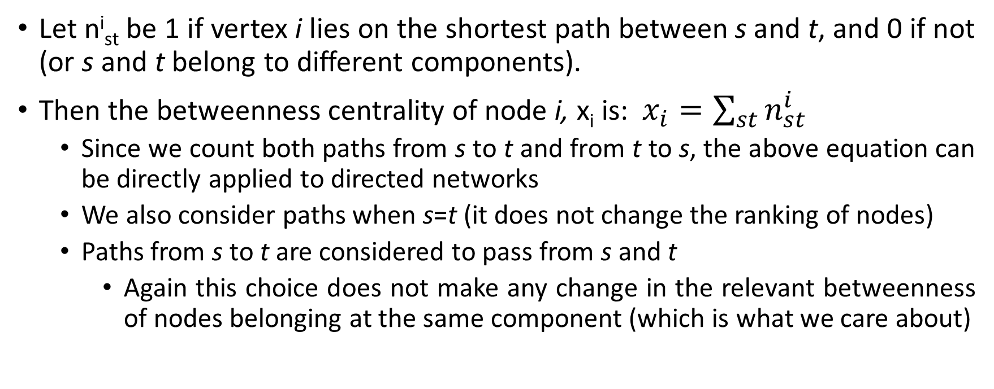
Betweenness centrality
Let n^{i}_{st} be 1 if vertex i lies on the shortest path between s and t, and 0 if not (or s and t belong to different components).
Then the betweenness centrality of node i, x_{i} is: $x_{i}=\sum_{st}{n_{st}^{i}}$
Since we count both paths from s to t and from t to s, the above equation can be directly applied to directed networks
We also consider paths when s=t (it does not change the ranking of nodes)
Paths from s to t are considered to pass from s and t
Again this choice does not make any change in the relevant betweenness of nodes belonging at the same component (which is what we care about)

Slide 11
Betweenness centrality
The betweenness centrality defined in the previous slide hold if there is at most 1 shortest path between two vertices
This is not the case though in real networks → multiple shortest paths share some nodes between them
The standard extension is to consider a weight for every shortest path between the pair (s,t)
Weight is equal to the inverse of the number of shortest paths between (s,t)
Betweenness of a vertex is then simply the sum of the weights of the shortest paths crossing this vertex

Slide 12
Betweenness centrality
Formally, we redefine n^{i}_{st} to be the number of shortest paths between s and t that pass through i, while g_{st} is the total number of shortest paths between s and t. Then:
Terms where g_{st}=0, are not considered, since this means that s and t belong to different components
Similar definitions exist for directed networks, but betweenness is rarely used in this case
Compute

Slide 13
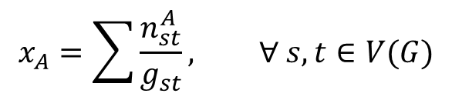
Ex: Betweenness Centrality
Fraction of shortest paths that include vertex A
$$x_{A}=\sum{\frac{n_{st}^{A}}{g_{st}}, ∀ s, t∈V(G)}$$
Steps:
Compute a matrix that computes the
total number of paths from each node to
all other nodes
2. Consider the shortest paths that include A

Slide 14
Betweenness centrality
Betweenness centrality captures how much a vertex falls between others, in contrast with other centrality measures we have seen, which capture how well connected the node is
A vertex can have low degree/eigenvector/closeness etc. centralities but high betweenness centrality
A is a broker vertex

Slide 15
Bounds for connected graphs
Betweenness exhibits a large dynamic range of values
What is the minimum value of betweenness centrality a vertex can have in connected graphs?
A leaf node:
2n-1
What is the maximum value of betweenness centrality a vertex can have in connected graphs?
center of a star in the largest component:
n²-(n-1)
As network evolves betweenness values can shift but the ordering at the top of the list changes relatively infrequently

Slide 16
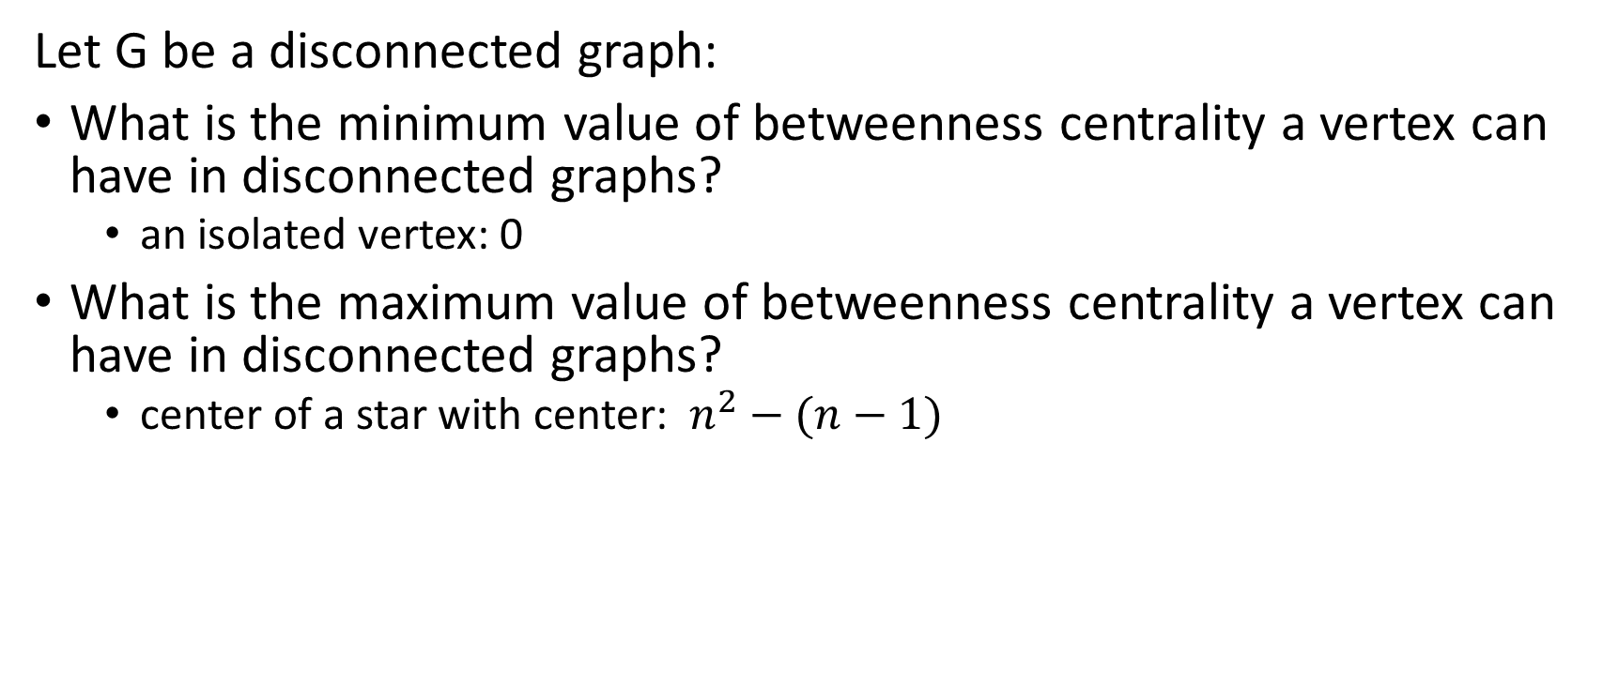
Bounds for disconnected graphs
Let G be a disconnected graph:
What is the minimum value of betweenness centrality a vertex can have in disconnected graphs?
an isolated vertex: 0
What is the maximum value of betweenness centrality a vertex can have in disconnected graphs?
center of a star with center: $n^{2}−(n−1)$

Slide 17
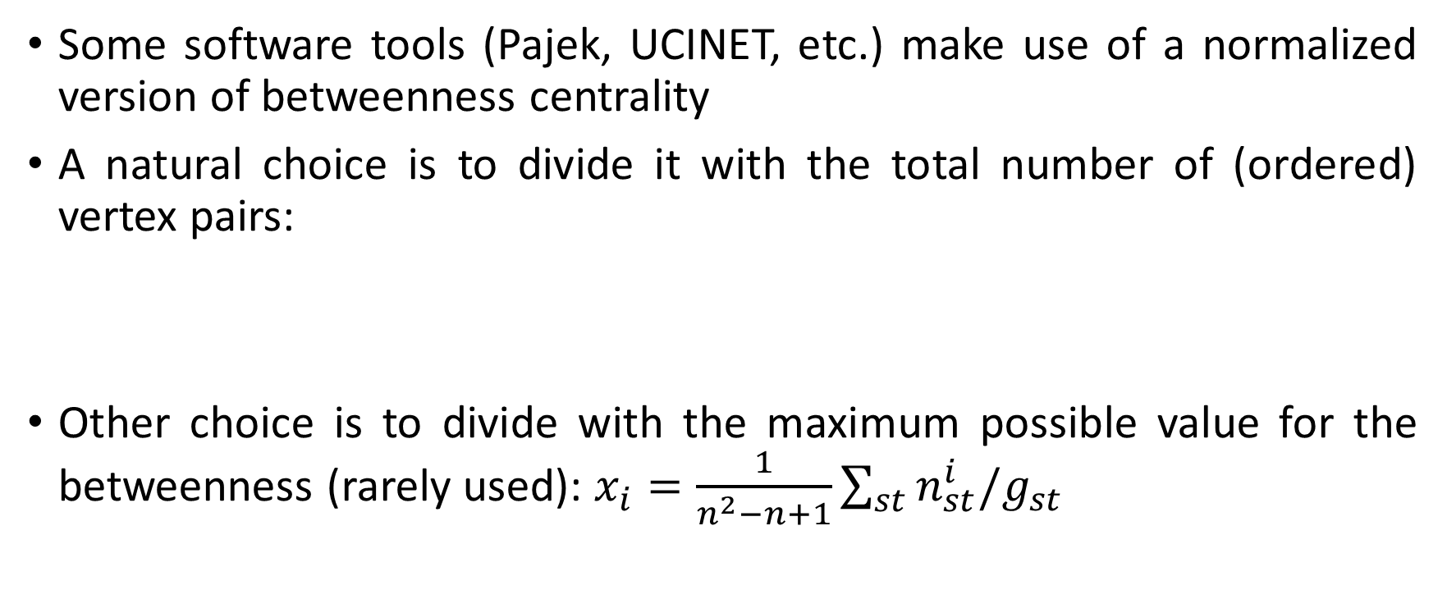
Normalized betweenness
Some software tools (Pajek, UCINET, etc.) make use of a normalized version of betweenness centrality
A natural choice is to divide it with the total number of (ordered) vertex pairs:
Other choice is to divide with the maximum possible value for the betweenness (rarely used): $x_{i}=\frac{1}{n^{2}−n+1}\sum_{st}{n_{st}^{i}/g_{st}}$

Slide 18
Flow betweeenness
In reality shortest paths are not always followed
E.g., think of how many times you have heard some news about a friend of yours not from him/her directly but from a third person
Flow betweenness makes some allowances for effects like this
Relevance with maximum flow
Is defined from the same equation but now n^{i}_{st} is the amount of flow through vertex i when the max flow is transmitted from s to t
From Menger’s theorem, n^{i}_{st} is the number of edge independent paths between s and t that pass through i

Slide 19
Flow betweenness
The edge independent paths are not necessarily unique
Some vertices might be part of one maximal set of edge independent paths but not of others
Freeman et al. define the flow through
a vertex, such as A, to be the maximum
possible flow over all possible choices
of paths
Hence, in the topology presented the flow between s and t would contribute 1 to the centrality of A

Slide 20
Random-walk betweenness
Flow centrality might miss shortest paths at all
Hence, no matter which definition we are using from the ones presented we might not consider important paths for different reasons
Random-walk betweenness aims at counting all paths
Traffic between s and t is thought of as following a random walk with absorbing state (state t)
n^{i}_{st} is the number of times that the random walk from s to t passed through node i averaged over many repetitions of the walk

Slide 21
Random-walk betweenness
Random-walk betweenness captures the betweenness centrality of a vertex in a network where information wonders around in the network at random
On the opposite extreme shortest path betweenness captures the centrality when information flows over a known path
The truth is a real network should lay somewhere in between…

